Slide 1

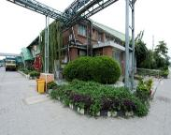
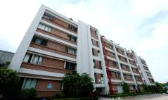
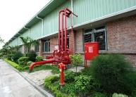
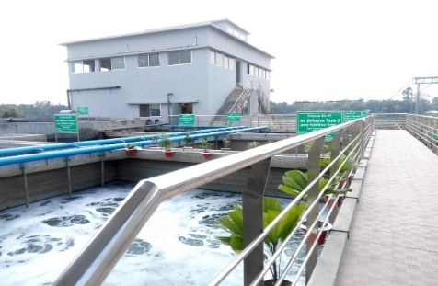
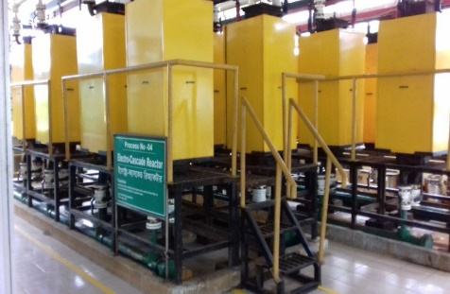
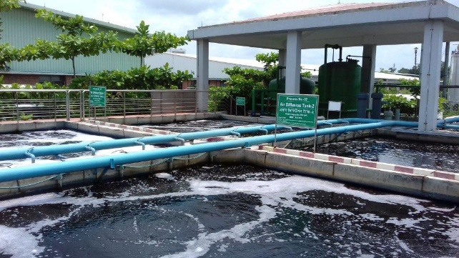
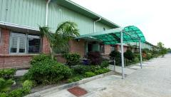
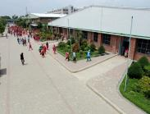
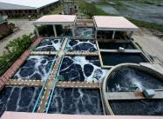
Tarasima Apparels Ltd.
Compliance Status

Slide 2







CERTIFICATION STATUS
SL No | Name of Certification | Audit Company | Present Status | Target | Height Category | Last Audit Date | Next due Date | Remarks
1 | SEDEX (Supplier Ethical Data Exchange) | SGS | Pass | Pass | Pass | 13-Mar-18 | Mar-19
2 | OHSAS-18001 (Occupational Health & Safety Assessment Series) | SNR | Pass | Pass | Pass | 26-Aug-17 | Aug-18 | Own
3 | Accord | Accord | Certified | Certified | Certified | 11-April-18 | Oct-18 | Lead Brand Benetton
4 | Alliance | Alliance | Certified | Certified | Certified | 23-Oct-17 | --------- | Lead Brand Vf
5 | amfori BSCI (Business Social Compliance Initiative) | SGS | C Acceptable | B Good | A Outstanding | 28-Jun-18 | Jun-19 | For LIDL
6 | LEED (Leadership in Energy and Environmental Design) | Innowell Engineering International Pvt Ltd | Platinum | Keep continue to Platinum | N/A | 2016 | Year 2020 | Platinum 93/110

Slide 3
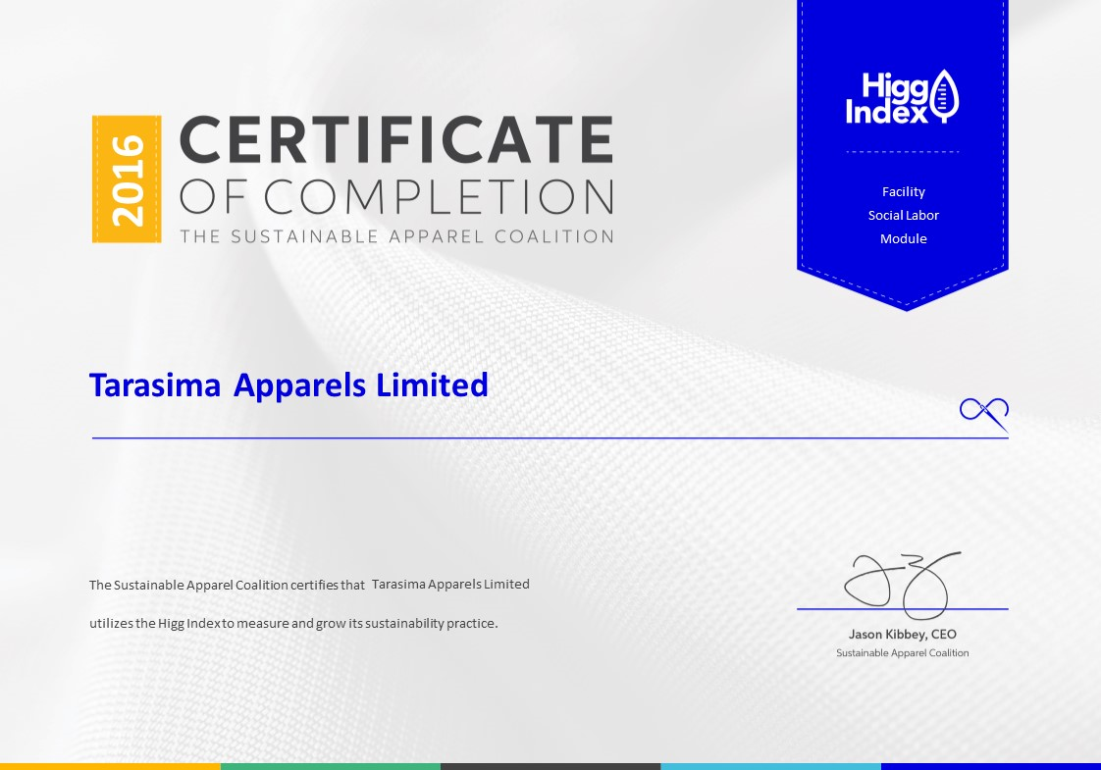
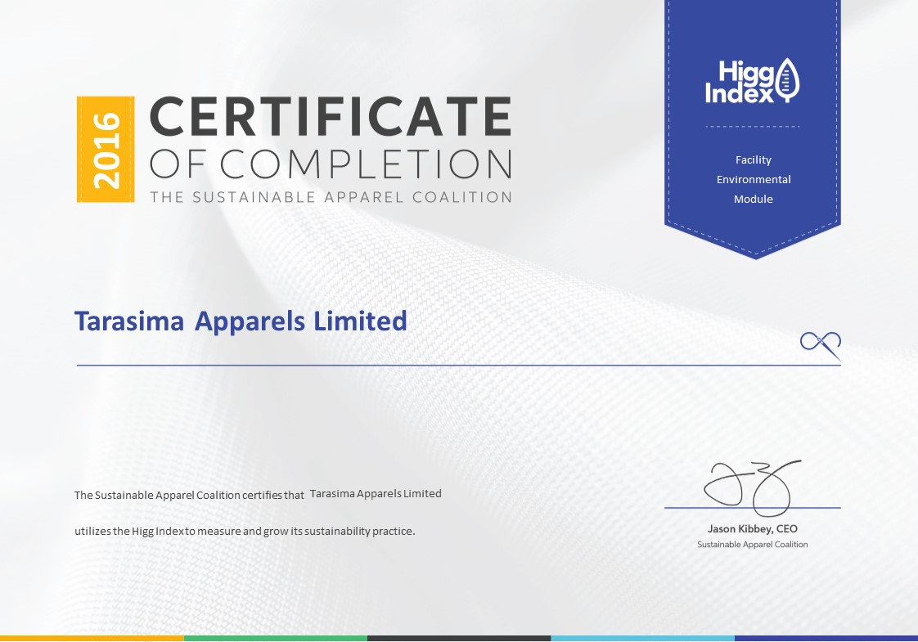



CERTIFICATION STATUS
SL No | Name of Certification | Audit Company | Present Status | Target | Height Category | Last Audit Date | Next due Date | Remarks
7 |  | HIGG (Social) | Platinum | 60% | Platinum | 1-Aug-17 | July-18 | Present Score 54%
8 |  | HIGG (Environment) | Platinum | 60% | Platinum | 1-Aug-17 | July-18 | Present Score 58%
9 | RCS Recycled Claim Standard) | Controlunion | Pass | Pass | Pass | 13-Aug-17 | Aug-18 | For H&M
10 | OCS (Organic Content Standard) | Controlunion | Pass | Pass | Pass | 13-Aug-17 | Aug-18 | For H&M
11 | GOTS (Global Organic Textile Standard) | Controlunion | Pass | Pass | Pass | 02-Nov-17 | Nov-18 | For LIDL

Slide 4

CERTIFICATION STATUS
SL No | Name of Certification | Audit Company | Present Status | Target | Height Category | Last Audit Date | Next due Date | Remarks
12 | OEKO-TEX | HOHENSTEIN | Pass | Pass | Pass | ------ | Aug-2018 | For LIDL

Slide 5
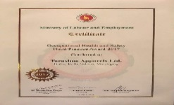

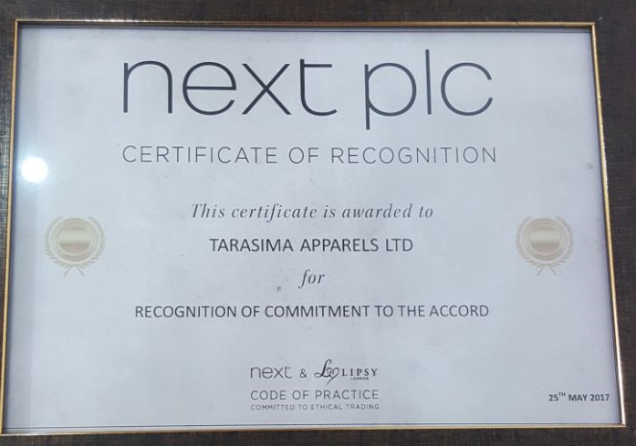



AWARD STATUS OF TARASIMA
SL No | Name of Award | Award Organization | Year | Remarks
1 | Occupational Health and Safety Good Practice Award-2017 | Ministry of Labour and Employment | 2018
2 | Gold Supplier | H&M | 2018
3 | Certification of Recognition | NEXT | 2017
4 | Operation Excellence | H&M | 2016
5 | Waste Water Management-2016 | DECATHLON | 2016
6 | Chemical Management | Deutsche Gesellschaft fur International Zusammenarbeit (GIZ) German and Huntsman (Singapore) Pte Ltd. | 2016

Slide 6


